Slide 1

Mini Project-I (K24MCA18P) Odd Semester Session 2024-25
CanKiet: Online Canteen System
Nilesh Agrahari 202410116100134
Nancy Gupta 202410116100130
Nishant Raikwar 202410116100135
Project Supervisor:
Ms. Divya Singhal
Assistant Professor

Slide 2
Content
Introduction
Literature Review
Objective of the Project
Technology ( Hardware and Software Requirements)
Modules
Workflow
Reports
References
Notes:
Font Styles: Times New Roman + Font Size: 25

Slide 3
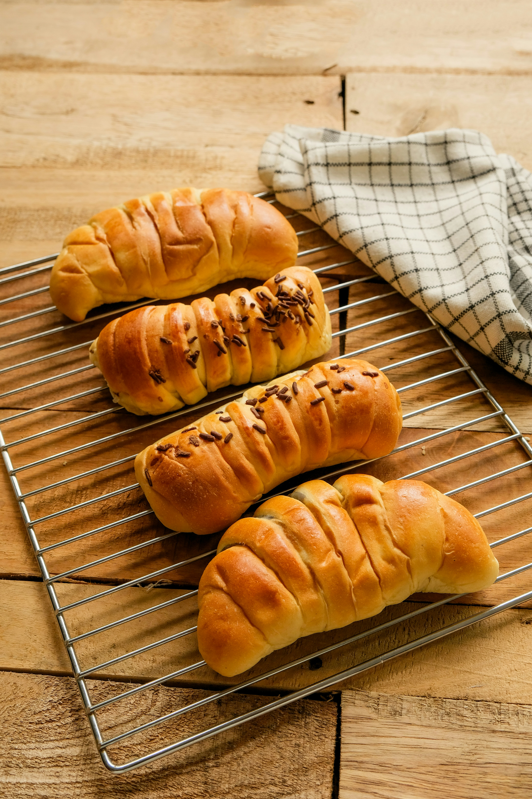
Introduction
The Online Canteen system is a digital platform that simplifies food ordering within institutional settings.
Users can browse menus, place orders, and make payments online, minimizing queues and manual transactions.
The system aims to streamline operations, reduce food wastage, and enhance the overall canteen experience.
Notes:
Font Styles: Times New Roman + Font Size: 25

Slide 4
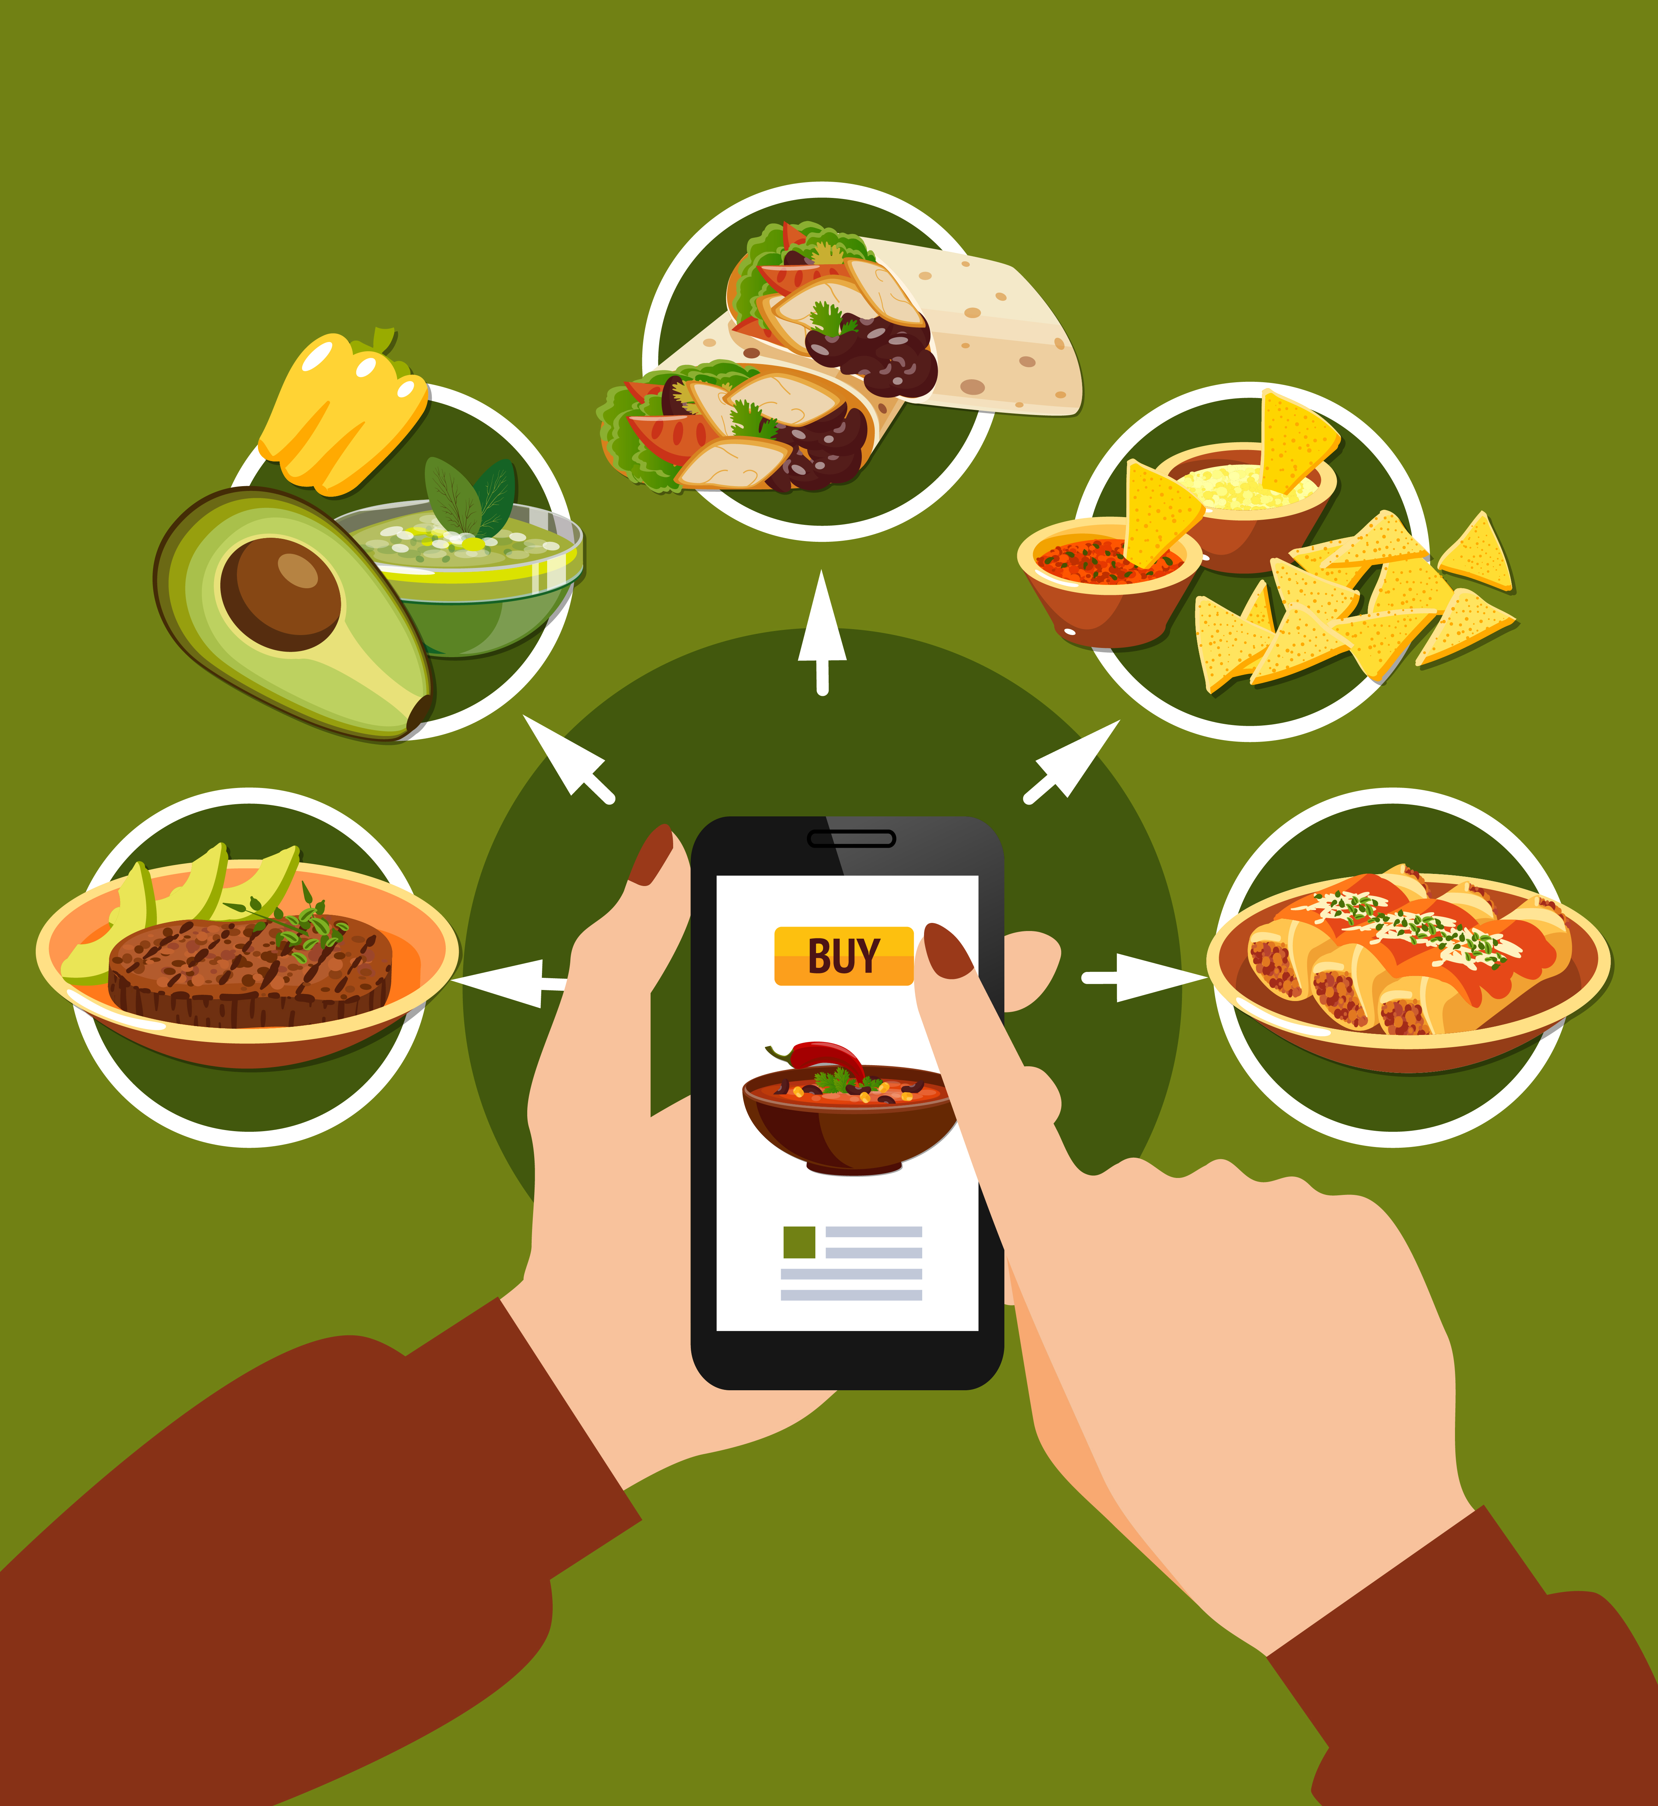
Literature Review
E-commerce & Food Ordering Systems: Studies emphasize the importance of convenience and user experience in online food services (Jain et al., 2020).
Canteen Management: Research highlights inefficiencies in traditional canteens, recommending digital solutions for better management (Kumar & Sharma, 2018).
Payment Systems & Security: Secure payment gateways are critical to building user trust in online platforms (Patel & Mehta, 2020).
Notes:
Font Styles: Times New Roman + Font Size: 25

Slide 5
Objective of the Project
To develop an efficient and user-friendly platform for canteen operations.
To automate the ordering, payment, and inventory management processes.
To reduce food wastage by using real-time demand forecasting.
To improve customer satisfaction by minimizing waiting time and enhancing service quality
Notes:
Font Styles: Times New Roman + Font Size: 25

Slide 6
Technology
HARDWARE REQUIEMENTS
SOFTWARE REQUIREMENTS
Operating System : Windows 10 (later)
Web Server : GUNICORN
RAM : min 2 GB
UI Technology : HTML, CSS, JS, BOOTSTRAP, TAILWIND
Hard Disk Space : min 20 GB
Database : MYSQL
Processor : core i3(or higher)
Back-end : DJANGO
(Python Framework)
Notes:
Font Styles: Times New Roman + Font Size: 25

Slide 7
Modules
User Module: Enables browsing of the menu, placing orders, and making payments.
Order Processing Module: Manages the order flow, from receiving to fulfillment.
Inventory Management Module: Tracks stock levels, updates based on orders, and sends notifications for low-stock items.
Payment Module: Handles secure transactions and provides payment history for users and administrators.
Notes:
Font Styles: Times New Roman + Font Size: 25

Slide 8

Workflow/Gantt Chart
DESIGN PHASE
IMPLEMENTATION PHASE
Entity Relationship Diagram
Data Flow Diagram
Data Structure
TESTING & DEPLOYMENT
PHASE
Database Development
Back-End Development
Front-End Development
Unit Testing
System Testing
Deployment
Notes:
Font Styles: Times New Roman + Font Size: 25

Slide 9
Reports
Menu: Display menu of foods, highlight popular items, and track any changes in offerings based on customer preferences.
Order History :Summarize orders, such as peak ordering times or frequently purchased items. This data can help with inventory and staffing decisions.
Customer Feedback: Present aggregated feedback data, highlight common themes, and summarize satisfaction ratings. Include action taken based on feedback.
Contact: Provide phone numbers, email addresses, and social media links. List the canteen’s operating hours.
Notes:
Font Styles: Times New Roman + Font Size: 25

Slide 10
References
Zomato: https://www.zomato.com/
Swiggy: https://www.swiggy.com/
Github: https://github.com/
Lucidchart: https://www.lucidchart.com/pages/?
Freepik: https://www.freepik.com/
Notes:
Font Styles: Times New Roman + Font Size: 25

